Slide 1

Animation
Notes:
Powerful way to add dimension

Slide 2
Theory
Notes:
Theory, then practicalities

Slide 3
What Is Animation?
Animation: creating the illusion of change or movement
Not the same as interaction (which is user-controlled)
Notes:
Interaction can trigger animation

Slide 4
Uses
Show dynamic process in real time
Show variation of a value over time
Navigate a virtual space
Draw user’s attention
Indicate UI activity (folder opening, waiting)

Slide 5
Reasons to Use
It’s engaging
It can represent another dimension (time)
It focuses attention powerfully
It can help the user retain context

Slide 6
Reasons Not to Use
It’s flashy
It requires replaying for analysis
It draws attention powerfully
It may add to cognitive load
Notes:
Avoid using for flashiness alone

Slide 7
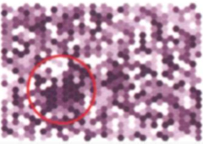
Does Animation Help?
No clear advantage over series of stills (Twersky, Morrison, and Betrancourt, 2002)
Can help users find correct answers faster (Griffin et al., 2006)
Compared to static maps, can help with time or attribute properties more than spatial ones (Lobben, 2008)
Notes:
Twersky reviewed 20+ studies.
Griffin et al., animation vs. small multiples.
randomly generated moving dots
Lobben, Type of data matters.

Slide 8
Practicalities

Slide 9
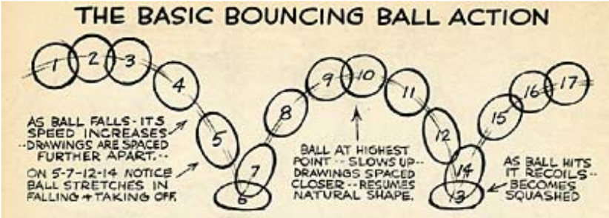
Animation Principles
Replace sudden transitions with smooth ones. (d3.transition() does this well.)
Fiddle with solidity
Exaggerate change (d3’s .ease() options)

Slide 10
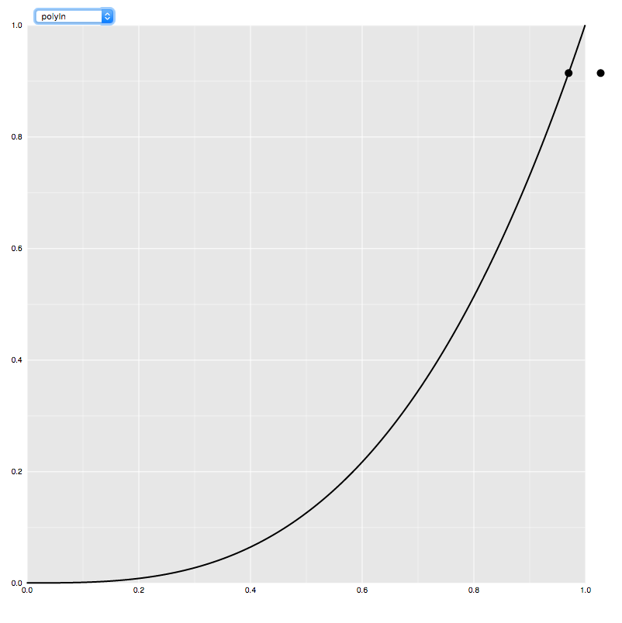
Try it Out
Play with these examples of easing in d3 to get a feel for what they do.
http://bl.ocks.org/mbostock/248bac3b8e354a9103c4

Slide 11
Animation in Visualization
Change one thing at a time
Use staging if need to change more at once
Avoid radical changes
Don’t animate hard-to-follow changes
Avoid unnecessary motion
Excess motion is confusing
What is constant shouldn’t move
Modified from Fisher, in Beautiful Visualization
Notes:
Hope this helps in
Choosing a library
Making animations

Slide 12


